Slide 1
Data Structures Week 1
Global Snapshots for FIFO channels
– Chandy lamports Algorithm

Slide 2
Chandy-Lamport’s Algorithm
Uses special marker messages.
One process acts as initiator, starts the state collection by following the marker sending rule below.
Marker sending rule for process P:
    P records its state and
    For each outgoing channel C from P on which a marker has not been sent already, P sends a marker along C before any further message is sent on C

Slide 3
Chandy Lamport’s Algorithm contd..
When Q receives a marker along a channel C:
  If Q has not recorded its state then Q records its state and also records the state of C as empty; Q then follows the marker sending rule
  If Q has already recorded its state, it records the state of C as the sequence of messages received along C after Q’s state was recorded and before Q received the marker along C
INDIAN INSTITUTE OF TECHNOLOGY KHARAGPUR

Slide 4
Chandy Lamport’s Algorithm contd..
  If Q has already recorded its state, it records the state of C as the sequence of messages received along C after Q’s state was recorded and before Q received the marker along C
  Say a marker is received by Pj from say Pi where Pj has already recorded its state. Now there can be no messages sent from Pi to Pj from when Pi records the state to when Pi sends out the markers. Hence this msg received was sent before Pi marked its state and received after Pj marked its state. Thus, this msg belongs to the transit messages in Channel (Pi, Pj)
INDIAN INSTITUTE OF TECHNOLOGY KHARAGPUR

Slide 5
Notable Points
Markers sent on a channel distinguish messages sent on the channel before the sender recorded its states and the messages sent after the sender recorded its state
The state collected may not be any state that actually happened in reality, rather a state that “could have” happened
INDIAN INSTITUTE OF TECHNOLOGY KHARAGPUR

Slide 6
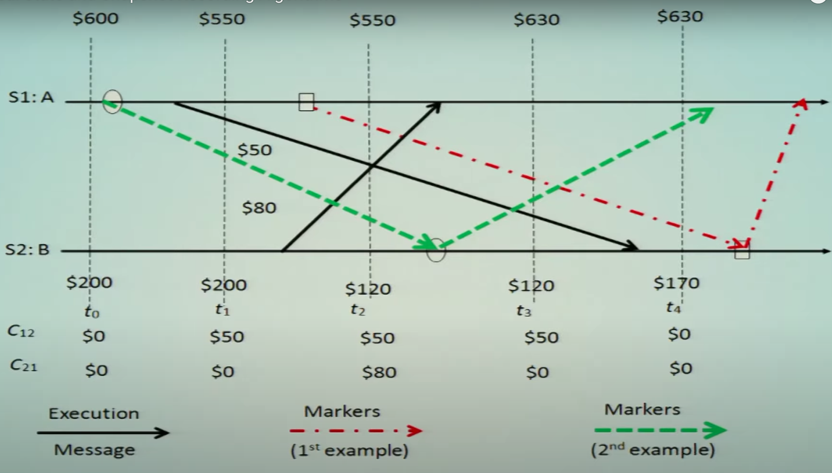
Example
Data Structures Week 1

Slide 7
Data Structures Week 1
https://www.lrde.epita.fr/~renault/teaching/algorep/06-snapshot.pdf
Has a running example

Slide 8
Process having received a marker
Once a process P receives a marker for the first time he records his state. Lets look at what kinds of msgs he can now receive. Pls mark for each if it’s a transit msg or not.
From the initiator – a msg sent before the initiator sent him a marker
From the initiator – the marker msg
Msg from some process that has not received a marker yet
Msg from some process that has received its marker and is sending marker to P
Msg from some process that has received its marker and has already sent a marker to P and is now sending some other msg
INDIAN INSTITUTE OF TECHNOLOGY KHARAGPUR

Slide 9
Notable Points
Markers sent on a channel distinguish messages sent on the channel before the sender recorded its states and the messages sent after the sender recorded its state
The state collected may not be any state that actually happened in reality, rather a state that “could have” happened
Will it work if not FIFO channels?
Message complexity ?
INDIAN INSTITUTE OF TECHNOLOGY KHARAGPUR

Slide 10
Notable Points
Markers sent on a channel distinguish messages sent on the channel before the sender recorded its states and the messages sent after the sender recorded its state
The state collected may not be any state that actually happened in reality, rather a state that “could have” happened
Message complexity ?O(|E|), where E = no. of links
INDIAN INSTITUTE OF TECHNOLOGY KHARAGPUR

Slide 11
Chandy-Lamport algorithm – FIFO Channels
This algorithm presented by Mani Chandy and Leslie Lamport works for FIFO channels.
If channel was not FIFO then the msgs sent after marker would reach before marker and get put into the transit messages list.

Slide 12
Chandy-Lamport algorithm – FIFO Channels
The Chandy-Lamport algorithm uses a control message, called a marker whose role in a FIFO system is to separate messages in the channels.
After a site has recorded its snapshot, it sends a marker, along all of its outgoing channels before sending out any more messages.
A marker separates the messages in the channel into those to be included in the snapshot from those not to be recorded in the snapshot.
A process must record its snapshot no later than when it receives a marker on any of its incoming channels.

Slide 13
Chandy-Lamport algorithm – FIFO Channels
The algorithm can be initiated by any process by executing the “Marker Sending Rule” by which it records its local state and sends a marker on each outgoing channel.
A process executes the “Marker Receiving Rule” on receiving a marker.
If the process has not yet recorded its local state, it records the state of the channel on which the marker is received as empty and executes the “Marker Sending Rule” to record its local state.

Slide 14
Termination Condition
The algorithm terminates after each process has received a marker on all of its incoming channels.
All the local snapshots get disseminated to all other processes and all the processes can determine the global state.

Slide 15
Correctness and Complexity
Correctness
C1: send(m_{ij})∈ LS_{i} ⇒ m_{ij} ∈ SC_{ij} ⊕ rec(m_{ij})∈LS_{j}.
C2: send(m_{ij})∉ LS_{i} ⇒ m_{ij} ∉ SC_{ij} Ʌ rec(m_{ij}) ∉ LS_{j}.
C2: Due to FIFO property of channels, it follows that no message sent after the marker on that channel is recorded in the channel state. Thus, condition C2 is satisfied.
C1: When a process p_{j} receives message m_{ij} that precedes the marker on channel C_{ij} , it acts as follows: If process p_{j} has not taken its snapshot yet, then it includes m_{ij} in its recorded snapshot. Otherwise, it records m_{ij} in the state of the channel C_{ij} . Thus, condition C1 is satisfied.
Complexity
The recording part of a single instance of the algorithm requires O(e) messages.

